Slide 1





THOUGHT LEADERSHIP SPONSORSHIP
Get a jump on the competition.
Maximize your company’s event exposure via thought leadership programs designed to showcase your products and services, expand brand awareness and drive qualified lead capture.
Anaheim 2021

Slide 2

TECH THEATER
$4,000 or $2,600 without video
Tech Theater Deliverables:
Pre-Event
Presentation title, abstract, and speaker’s bio and photo promoted on the event website and event mobile app
Onsite
45-minute speaking slot, plus 5 minute prep and 10 minute Q&A.
Presentation promoted in show guide and onsite signage
Training and/or sales literature placed on attendee seats
Post-Event
Professionally recorded and edited video of presentation – You receive a link to the video asset, and your video will be housed on your choice of digital supplier directory
Contact information of session attendees provided post event
Access to online leads/video downloads post event
All Tech Theater with videos will be hosted on the Supplier Directory of your choice: Qmed, Design News, or Packaging Digest.
Your video can be viewed from the directory’s online video library or directly from within your company’s directory listing.
All video content can be accessed via a landing page to allow for lead capture.

Slide 3
LUNCH & LEARN
$15,000
Address an elite, hand picked audience based on job title and function with this 60-minute speaking slot. It’s the ideal combination of formal education and casual interaction. UBM handles the venue, menu, and guest list – you bring your expertise!
Average audience size = 80-100 attendees.
Package includes:
  15-minute pre-session demo/room prep and 60 minute presentation
  Presentations promoted via onsite signage, event website and mobile app
  Contact information of session attendees provided post event
  Distribution of training and sales collateral
  Lunch for up to 85 participants

Slide 4
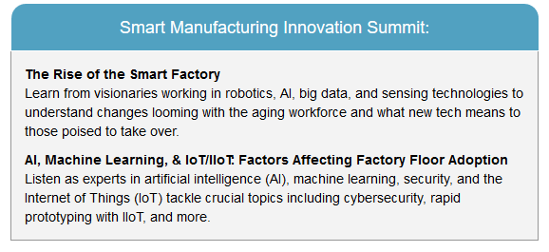
SMART MANUFACTURING INNOVATION SUMMIT
$6500
Sponsorship delivers branding and lead generation among influential conference delegates and includes:
Contact information of all conference attendees provided post-event
Company logo on signage outside the session room and on holding screens in session rooms
Training and/or sales literature available to conference attendees
Lead capture of all Smart Manufacturing session attendees
One All Access Conference Pass
Price: $4000 for sponsorship across all three days.
Demonstrate your expertise by delivering thought leadership on the Smart Manufacturing agenda! 2 speaking slots available. 11AM – 12PM on Tuesday or Wednesday. $2500 per speaking slot and includes promotion and lead capture.

Slide 5
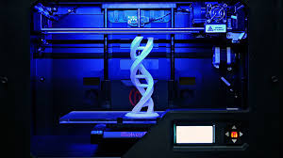
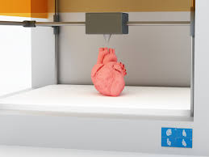
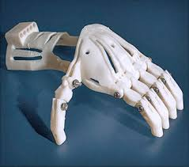
3D PRINTING INNOVATION SUMMIT
CONFERENCE SPONSORSHIP
Sponsorship: $6500
A must for engineering professionals working in the additive manufacturing space, this three-day conference will cover 3D printing with metal, the use of 3D printing in the medical arena, new technologies and materials, and more.
Sponsorship Includes
On-Site:
Company logo on all 3D Printing conference signage and on holding screens in session room
Training/Sales Literature seat drop
Two All Access Conference Passes
Post-Event:
Full list of 3DP conference attendees with name, title, company, e-mail, phone and address uploaded to Excel and e-mailed one week post event
Demonstrate your expertise by delivering thought leadership on the 3D Printing agenda! 2 speaking slots available. 11AM – 12PM on Tuesday or Wednesday. $2500 per speaking slot and includes promotion and lead capture.

Slide 6
CUSTOM SPEAKING PROGRAMS
Pricing Varies
Are you looking to differentiate your offerings from the competition via thought leadership?
Host a custom speaking program at the conference level and demonstrate your expertise in your field. Build relationships with influential decision makers in an intimate setting where you drive the discussion.
Your content promoted under the Education tab on the event website and in the printed show guide
Custom Email invitation to select Expo attendees – you will receive the full RSVP list
Full Contact information of workshop attendees, provided post-event
Full Page Ad in the official Show Directory
Logo in Show Directory and onsite signage
Training and/or sales literature on attendee seats in workshop room
Speaker Badges and Two (2) All Access Conference Passes for Half-Day
$7,995 for one hour, 15,500 for half-day, $21,000 for full-day

