Slide 1





ONSITE BRANDING
Get a jump on the competition.
Maximize your company’s event exposure by selecting from a variety of on-site opportunities designed to showcase your products and services.
ANAHEIM 2021

Slide 2
TABLE OF CONTENTS
Smart Bundles
Smart Bundle 1 , 2, & 3
Onsite Opportunities:
In-Booth Networking Happy Hour
Charging Station
Promotional Signage:
Ad Posters
Mega Signs
Tri-Mega Sign
Backlit Rotating Tower Expo Hall
LED Digital Display Panels
Floor Decals
Aisle Sign Sponsorship
Bag Sponsorship
Show Guide Print Advertising
Digital Daily Advertising
Geofencing/Retargeting Digital Ads
Private Meeting Rooms
Titanium Club Sponsorship
Mobile Advertising:
Mobile Alerts
Mobile Banner Ads

Slide 3
GET MORE EXPOSURE – UPGRADE TO A SMART BUNDLE!
Lead Retrieval App
Receive three lead retrieval license activations for the onsite Lead Retrieval app.
Access to Online Leads
Upgraded listings will receive name, job title, company and e-mail addresses of attendees seeking to meet with you.
Priority Placement on Online Search Results
Your listing receives priority placement on all online searches that match your product category and keywords.

Slide 4



SMART BUNDLES
Designed to increase your exposure for maximum attendee engagement!
Smart Bundle #1 | $1,390
Smart Bundle #2 | $2,500
Smart Bundle #3 | $3,890
CompuLEAD Smart Lead Retrieval App w/ (3) license activations
Exhibitor Profile Upgrades
  4 additional Product Tiles w/ Content (8 total)
  Floor Plan Corner Peel – your booth highlighted on the online Floor Plan
  1 Video Link on your online Exhibitor Profile
  Priority placement for your listing online product category & keyword search
  Access to online leads pre-event
CompuLEAD Smart Lead Retrieval App
Featured Exhibitor Package Plus
2 Online Product Category Sponsorships
Mobile App Banner Ad
Delivers 277% more traffic
on average than a Basic Listing
CompuLEAD Smart Lead Retrieval App
Featured Exhibitor Package Plus
Full Page Ad in Onsite Event Guide
Mobile App Banner Ad
2 Online Product Category Sponsorships
1 online Show Highlight Sponsorship
Delivers 560% more traffic on average than a Basic Listing

Slide 5
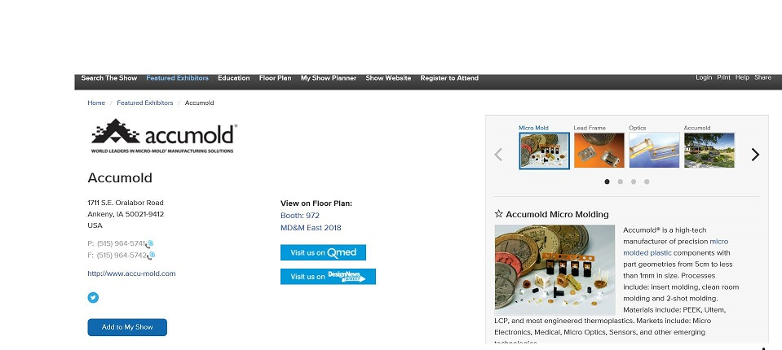

FEATURED EXHIBITOR PACKAGE
$850
Maximize your opportunity to generate leads. Package benefits include:
  Basic company listing with four (4) product highlights
  Four (4) additional product highlights
    Includes photo and content
  Priority placement in search results
    Event website and mobile app
  Mobile compatibility
    Exhibitor profile details sync seamlessly from the event website to the mobile app
  Access to online leads
Your Name Here
Company
Company Name

Slide 6
FEATURED EXHIBITOR PACKAGE PLUS
$1,390
The Featured Exhibitor Package Plus is included in ALL Smart Bundle packages.
Attract leads with eye catching visuals with this premier list of benefits:
  Featured Exhibitor Package
  Corner peel on digital floor plan
  Mobile compatibility
  Video panel
  A la carte options:
  Corner Peel ($410)
  Additional listing ($250)
  Premier Directory Listing – your booth highlighted with logo in the printed show directory ($400)
Exhibitors are eligible to sponsor the following event website pages:
  Product Categories – 5 sponsors per category
  Show Highlights – Limited to 21
  Directory Listing home page - Exclusive
  Floor Plan home page - Exclusive
Your Name Here
Company
Company Name

Slide 7




IN-BOOTH NETWORKING RECEPTION
$2,935
Meet and engage with buyers in a relaxed environment at the end of the day!
Three options to choose from:
  Beer/Wine for 100 guests
  Beer for 100 guests
  Wine for 100 guests
Your company, brand, and booth number promoted on onsite signage and Tour postcards distributed to event attendees
Booth Crawl Happy Hour Tour promoted on event website and in pre-event e-mails

Slide 8
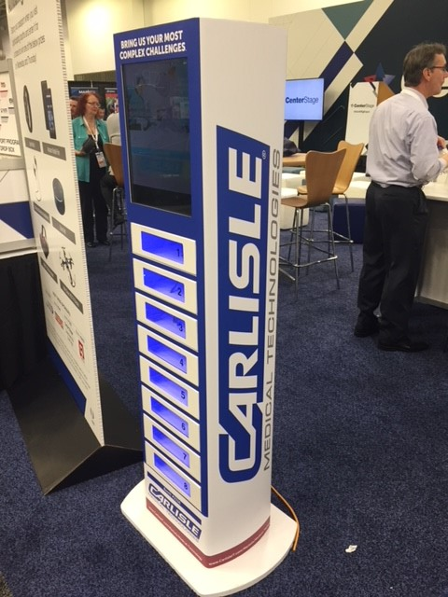
CHARGING STATION
$3,995
Help attendees stay connected throughout the show with a Charging Station sponsorship.
Wrap your branding around the station and play up to 5 hours of continuous educational content on the 10’5 inch embedded video screen throughout the duration of the event.*
Charging Stations are placed in high-traffic zones within the expo hall for maximum visibility!
*Content to be pre-approved by Informa Markets

Slide 9


PROMOTIONAL SIGNAGE
Strategically placed in high traffic areas, mega signs are above eye level and afford maximum exposure for your brand..
Mega Signs | $3,295
Tri -Mega Signs | $4,250
Reach the eyes of attendees at every angle with this three-sided signage. You can’t miss these prominent displays standing tall in strategically placed areas leading into the show.
Choose from these locations:
Registration Area
Lobby
Conference Entry Points
Tri-Mega Sign Specs:
8’ x 3’ Dimension | Up to (3) different images| Four Color
Mega Sign Specs:
8’ x 3’ Dimension | Double Sided | Four Color

Slide 10
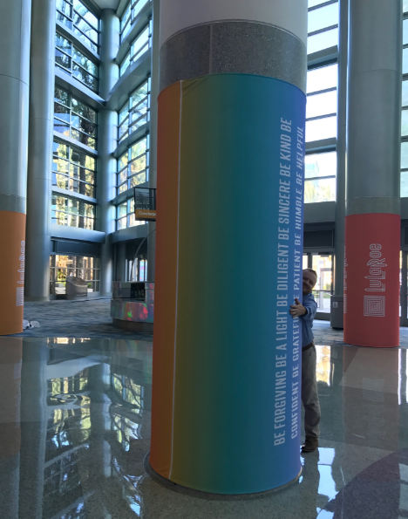
PROMOTIONAL SIGNAGE
Sold in sets of two, Ad Posters are strategically placed in high traffic areas inside the Expo Hall or Lobby, Ad Posters afford maximum exposure for your brand..
Ad Posters | $2,190
Column Wrap | $5,305
Reach the eyes of attendees with 360 degrees of high visibility advertising space. Attendees can’t miss the prominent columns standing tall in the highly trafficked lobby of the Anaheim Convention Center.
Choose from these locations:
Registration
Expo Hall
Conference Entry Points
Column Wrap Specs:
8’ tall – circumference varies by column.
Ad Poster Sign Specs:
22” x 28”’ Dimension | Double Sided | Four Color

Slide 11

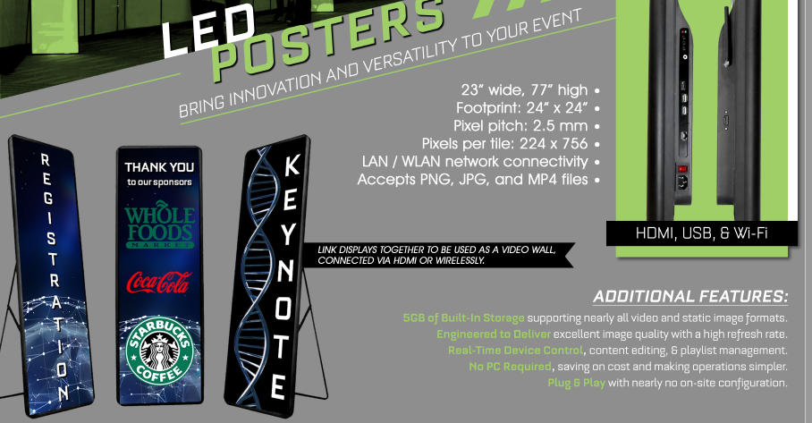
PROMOTIONAL SIGNAGE
LED Digital Display Signs | $1,995
LED displays bring innovation and versatility to your event!
Features include 5 GB of built-in storage supporting nearly all video and static image formats. Excellent image quality with high refresh rate, real-time device control, and no PC required.
Link displays together to be used as a video wall, connected via HDMI or wirelessly
LED Digital Display Specs:
23” wide, 77” high
Footprint: 24” x 24’
Pixel pitch: 2.5 mm
LAN/WLAN network connectivity
Accepts PNG, JPG, and MP4 files

Slide 12


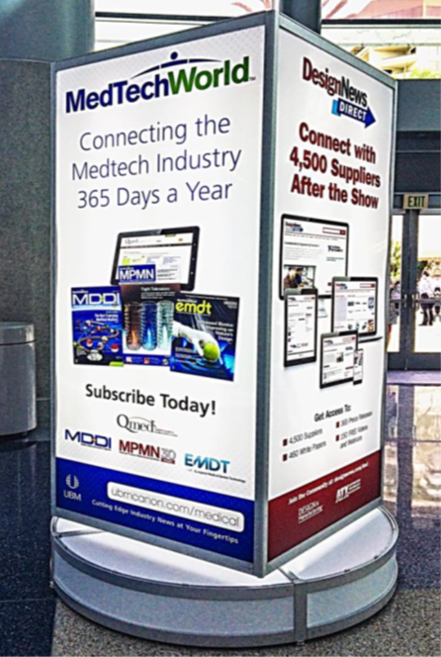
FLOOR DECALS | BACKLIT ROTATING TOWER
Floor Decals
$3,555 (1) | $5,460 (2)
Backlit Rotating Tower
$3,295 (1) | $10,015 (4)
Take over the expo floor – literally!
Feature your company name, booth number, and compelling messaging, and guide buyers straight to your booth.
Drive attention to your company at 360 degrees!
The backlit rotating tower allows you the option to use all four panels of marketing real estate or to purchase signage by panel.
Floor Decal Specs:
(2) 10’x4’ decals | Four Color

Slide 13
EXPO HALL AISLE SIGN SPONSORSHIP
$1,545
Aisle signs are your best option for brand and booth exposure on the expo floor. Hung below the numbered aisle markers, they provide a space for front-and-center messaging complete with your tagline, logo, booth number and website address.
Specs:
  48’ W x 18’ H
  Double-sided
Anaheim Aisles have two signs per aisle!
Per Aisle Sign | 4+ Aisle Signs
$1,545 | $1,250 each

Slide 14
BAG SPONSORSHIP
$5,000 - $8,500
Put your message into the hands of thousands. Bag sponsorships are an effective and unique way to appeal to buyers and make a lasting impression as they are carried throughout the expo floor.
We will place your sponsor-supplied bag on stands at strategic locations throughout the venue for the duration of the event.
$5,000 for 5,000 bags
$8,500 for 10,000 bags

Slide 15

PRINT ADVERTISING
Pricing Varies
Put it in print. Materials are available to all attendees and referenced throughout the day.
Show Guide Advertising:
Onsite Directory Advertising Options | 2019 RATE
Premium: Ad Runner | $7,500
Premium: Outside Back Cover | $6,540
Premium: Inside Front or Back Cover | $5,835
Premium: Facing Front Cover | $5,305
Premium: Opposite Table of Contents | $4,300
Full Page, 4 Color Advertisement | $2,950
Half Page, 4 Color Advertisement | $2,275
Ad Specs-
Trim: 8.5 x 10.5
Live Area: Keep live matter .25" from trim
Bleed: Pull bleed .25" beyond trim on all sides

Slide 16
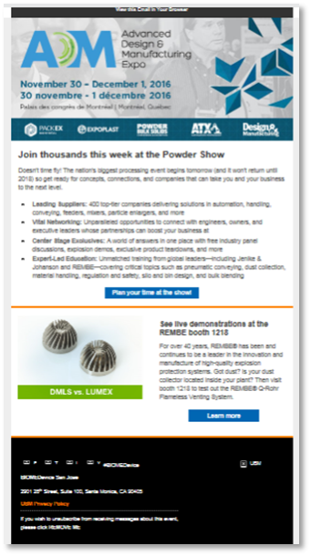


DIGITAL DAILY ADVERTISING
$795 or 895 per ad
Digital Daily Ads - $895 Each
Take advantage of messaging attendees on show days! Share your direct message, logo, booth number, and link to your company website in an attendee email scheduled on each day of the event.
*Content must be received ten (10) business days prior to deployment. Content subject to approval by Informa
Limited to 3 ads per deployment per show brand: MD&M, ATX, D&M, Pack and Plastec

Slide 17
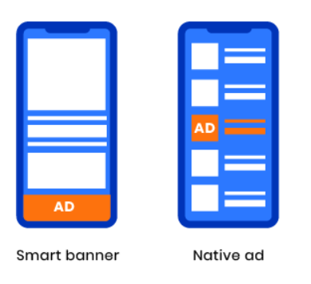
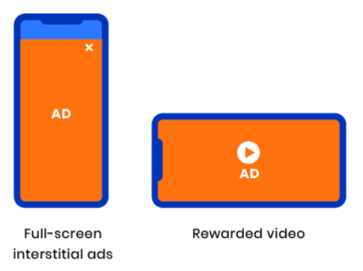
Geofencing/Retargeting– Targeted Mobile and Desktop Advertising
$2,575
Geofencing and Ad Retargeting is mobile and desktop ad serving technology that delivers your message directly to your audience on their phone, within the apps and on mobile websites they are accessing within a 1-mile radius of the convention center, then captures attendees’ mobile id’s and retargets them across each of their devices.
Ads use a variety of creative types and sizes. Impressions are served on mobile devices and tablets within the event, while users are browsing mobile web and in-app content like:
Weather, the Weather Channel
Navigation, MapQuest
News content, the New York Times
Games, CandyCrush
Travel, LoungeBuddy

Slide 18
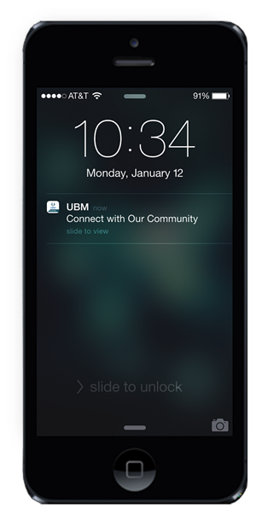
MOBILE ALERT PUSH NOTIFICATION
$875
Use the digital equivalent of the event guide to stay top of mind with attendees. Send your company message directly to the hands of event app users with Mobile Alert Push Notification.
Share up-to-the-minute information on booth giveaways, product launches, company news, or other relevant announcements.*
*Two (2) alerts available per day

Slide 19
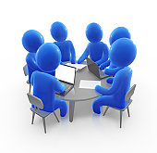
PRIVATE MEETING ROOMS
Are you planning to meet with your most important clients and prospects at the show?
Meeting Rooms, located on the 2nd level of the convention center, offer privacy to hold high-level conversations that can propel your business forward.
Pricing:
Full Day - $3500
½ Day - $2035
Catering and A/V is available. Contact Colleen Sepich to put together a customized program at 781-491-2042 or colleen.sepich@informa.com

Slide 20
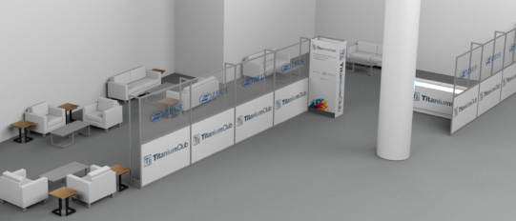
TITANIUM CLUB SPONSORSHIP
$12,360
Are you planning to meet with your most important clients and prospects at the show?
The Titanium Club is a meeting space and lounge area dedicated to providing a comfortable landing space for Medical Device OEM Engineers and Decision Makers.
Exclusive sponsorship of the Titanium Club provided the sponsoring company with branding, lead capture and face to face interaction with key attendees from these influential organizations.
Sponsorship Includes:
Full Page Ad in Show Guide
Branding on plexiglass windows on exterior of Titanium walls – see schematic
Access to Titanium Club for up to 5 sponsor staff members
Lead capture for all Titanium Club guests, provided in Excel post event

