Slide 1





PRE-EVENT MARKETING FOR ANAHEIM 2021
Get a jump on the competition.
Maximize your company’s event exposure by selecting from a variety of pre-show opportunities designed to showcase your products and services.
ANAHEIM 2021

Slide 2
TABLE OF CONTENTS
Smart Bundles
Smart Bundle 1 , 2, & 3
Pre-Event Exposure:
Featured Exhibitor Package
Featured Exhibitor Package Plus
Online Sponsorships – Directory & Floorplan
Product Category Sponsorship
Show Highlight Sponsorship
Online Expo Floor Plan Sponsorship
Send an Email
Attendee Outreach Ads
Registration Sponsorship

Slide 3
GET MORE EXPOSURE – UPGRADE TO A SMART BUNDLE!
Lead Retrieval App
Receive three lead retrieval license activations for the onsite Lead Retrieval app.
Access to Online Leads
Upgraded listings will receive name, job title, company and e-mail addresses of attendees seeking to meet with you.
Priority Placement on Online Search Results
Your listing receives priority placement on all online searches that match your product category and keywords.

Slide 4



SMART BUNDLES
Designed to increase your exposure for maximum attendee engagement!
Smart Bundle #1 | $1,390
Smart Bundle #2 | $2,500
Smart Bundle #3 | $3,890
CompuLEAD Smart Lead Retrieval App w/ (3) license activations
Exhibitor Profile Upgrades
  4 additional Product Tiles w/ Content (8 total)
  Floor Plan Corner Peel – your booth highlighted on the online Floor Plan
  1 Video Link on your online Exhibitor Profile
  Priority placement for your listing online product category & keyword search
  Access to online leads pre-event
CompuLEAD Smart Lead Retrieval App
Featured Exhibitor Package Plus
2 Online Product Category Sponsorships
Mobile App Banner Ad
Delivers 277% more traffic
on average than a Basic Listing
CompuLEAD Smart Lead Retrieval App
Featured Exhibitor Package Plus
Full Page Ad in Onsite Event Guide
Mobile App Banner Ad
2 Online Product Category Sponsorships
1 online Show Highlight Sponsorship
Delivers 560% more traffic on average than a Basic Listing

Slide 5
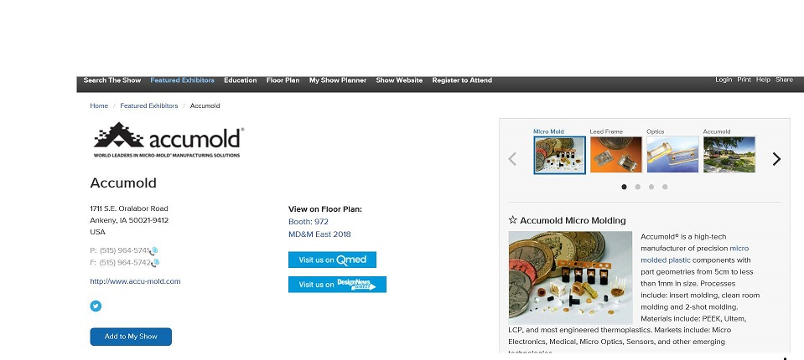

FEATURED EXHIBITOR PACKAGE
$850
Maximize your opportunity to generate leads. Package benefits include:
  Basic company listing with four (4) product highlights
  Four (4) additional product highlights
    Includes photo and content
  Priority placement in search results
    Event website and mobile app
  Mobile compatibility
    Exhibitor profile details sync seamlessly from the event website to the mobile app
  Access to online leads
Your Name Here
Company
Company Name

Slide 6
FEATURED EXHIBITOR PACKAGE PLUS
$1,390
The Featured Exhibitor Package Plus is included in ALL Smart Bundle packages.
Attract leads with eye catching visuals with this premier list of benefits:
  Featured Exhibitor Package
  Corner peel on digital floor plan
  Mobile compatibility
  Video panel
  A la carte options:
  Corner Peel ($410)
  Additional listing ($250)
  Premier Directory Listing – your booth highlighted with logo in the printed show directory ($400)
Exhibitors are eligible to sponsor the following event website pages:
  Product Categories – 5 sponsors per category
  Show Highlights – Limited to 21
  Directory Listing home page - Exclusive
  Floor Plan home page - Exclusive
Your Name Here
Company
Company Name

Slide 7



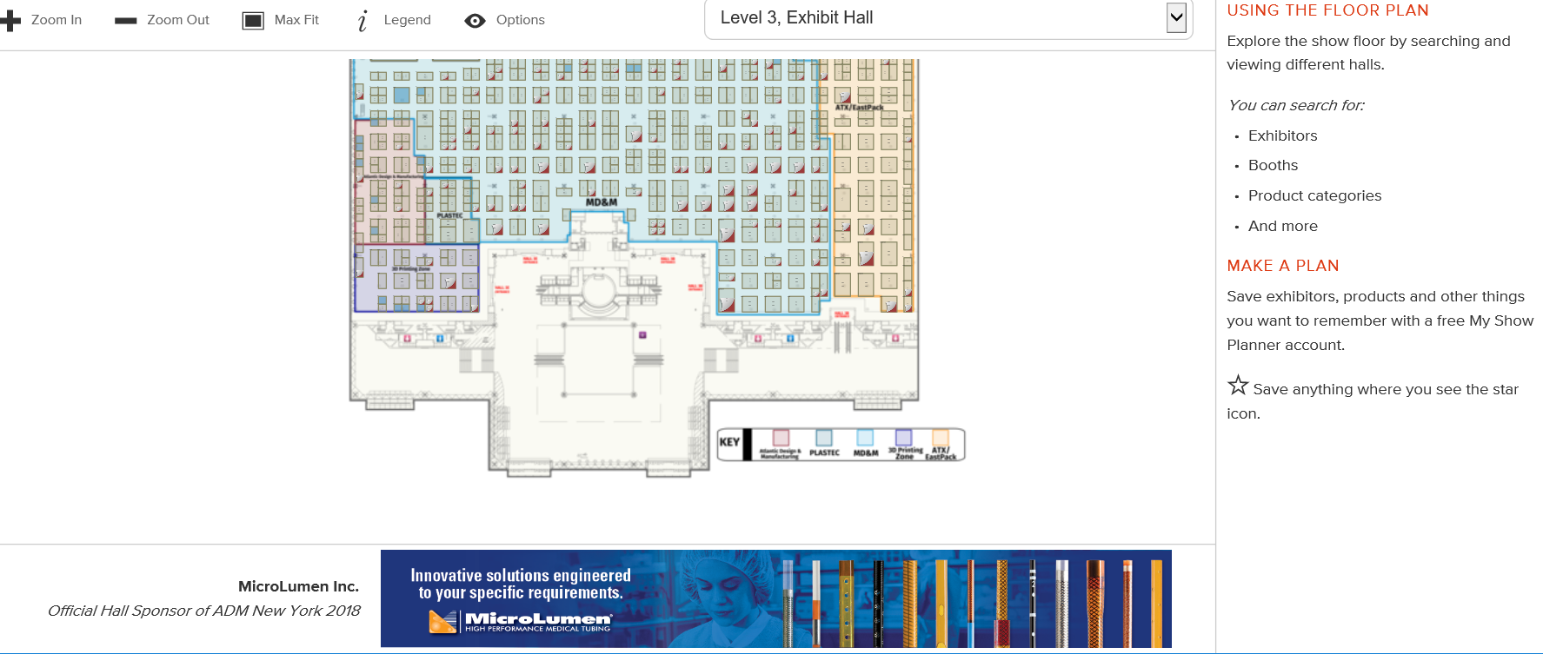
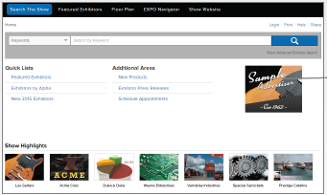
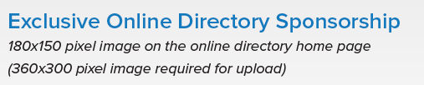
ONLINE SPONSORSHIPS
$3,195 each
Attendees frequently consult the online directory as a starting point when planning their visit to the event, as well as view the on-line floor plan. Be the first exhibitor they see when they visit these pages! Requires Featured Exhibitor Package Plus or Smart Bundle.
Online Directory Sponsorship
Online Floor Plan Sponsorship
Your Name

Slide 8
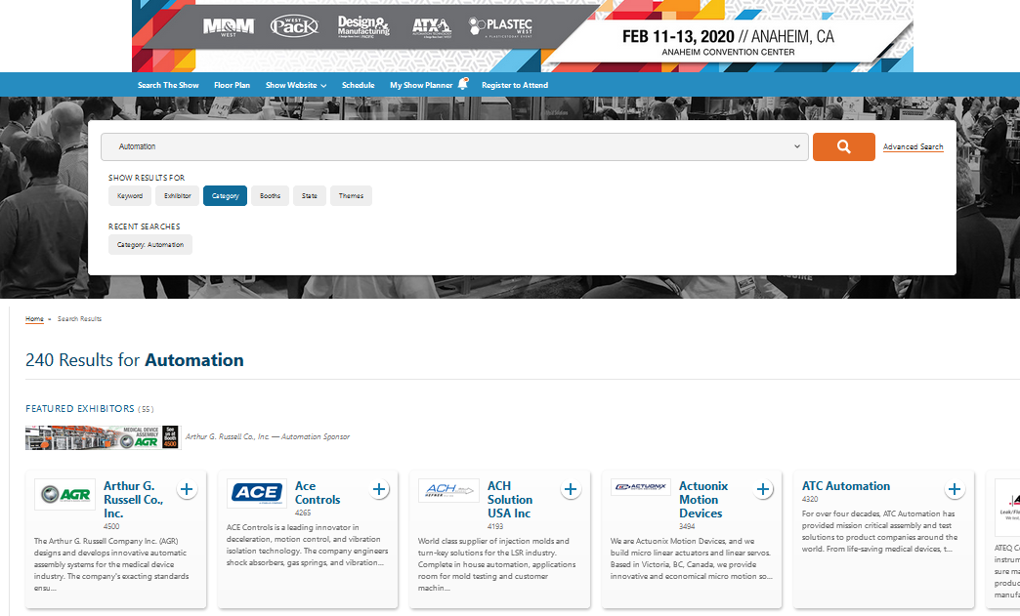
PRODUCT CATEGORY SPONSORSHIP
$745*
For Featured Exhibitor Plus holders, Attendees utilize the Exhibitor Directory to search for suppliers by Product Category, Keyword and Company Name.
Own the valuable real estate at the top of the search results!
Product Category Sponsors receive, on average, 277% more exhibitor profile views than exhibitors with Basic Listings
*$745 per category, Limit 5 sponsors per category

Slide 9
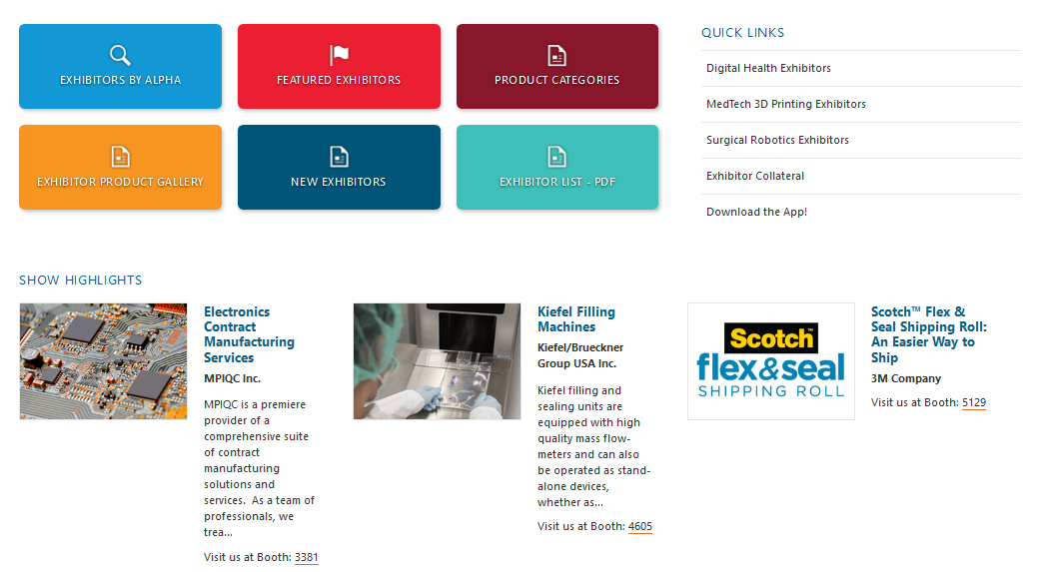
SHOW HIGHLIGHT SPONSORSHIP
$1055
Feature Exhibitor Package Plus holders – here is an extra opportunity for you.
The Exhibitor Directory home page is the most highly trafficked page on the event website. Make sure you are seen by featuring your products’ image or video as a highlight.
Exhibitors with Show Highlight Sponsorship receive, on average, 560% more Exhibitor Profile Views than Exhibitors with Basic Listings!
Limit 21 Show Highlights per event!

Slide 10
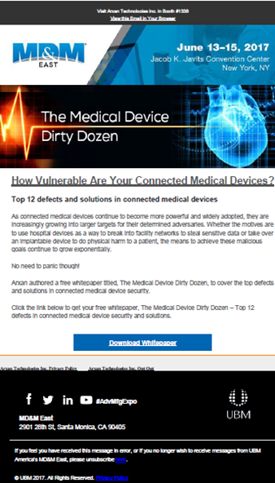

SEND AN EMAIL
Pricing Varies
Target potential and confirmed attendees prior to the event with an exclusive e-blast. You supply the email content (copy, image and company logo) and we’ll do the rest. We’ll create and deploy your dedicated event branded email to our unique audience.
Attendee Send An E-mail Campaigns
Plastec West 1500 records, 2 campaigns available | $2,100.00
Pacific Design & Manufacturing, 2000 records, 2 campaigns available | $2,600.00
ATX West 2000 records, 2 campaigns available | $2,600.00
WestPack 2500 records, 3 campaigns available | $3,100.00
MD&M West 3000 records, 8 campaigns available | $3,600.00

